Slide 1
LEAD SCORING CASE STUDY
BY: SREEDEVI GATTU & DISHANT PATEL

Slide 2
INDEX
PROBLEM STATEMENT
DATA CLEANING AND OUTLIER HANDLING
BUILDING OF LR MODEL AND IT’S EVALUATION
RECOMMENDATIONS

Slide 3
PROBLEM STATEMENT
BRIEF OVERVIEW: X Education sells online courses to industry professionals. The company markets it’s courses on various social media platforms & websites and through referrals. Interested people land to X Education’s website, browses for courses. These people are classified as ‘Leads’.
PROBLEM STATEMENT: The typical lead conversion rate at X Education is around 30% which is unsatisfactory. The company wants typical conversion rate to be above 80%. For this company wants to categorize a pool of candidates to be classified as hot leads, which conversion rate may be increased to 80%.
DATASET PROVIDED: Dataset of about 9000 clients have been provided which captures various features viz. there profession, Lead Source, Time spent on website etc., and whether they were converted or not.
EXPECTED SOLUTION: Build a Logistic Regression model and provide a score to each of the leads out of 100, and determine the cut off point, post which, the lead may be classified as ‘HOT’.
The model shall be explained in business terms and some more management problems mentioned in the document shall be answered on the basis of our model.

Slide 4
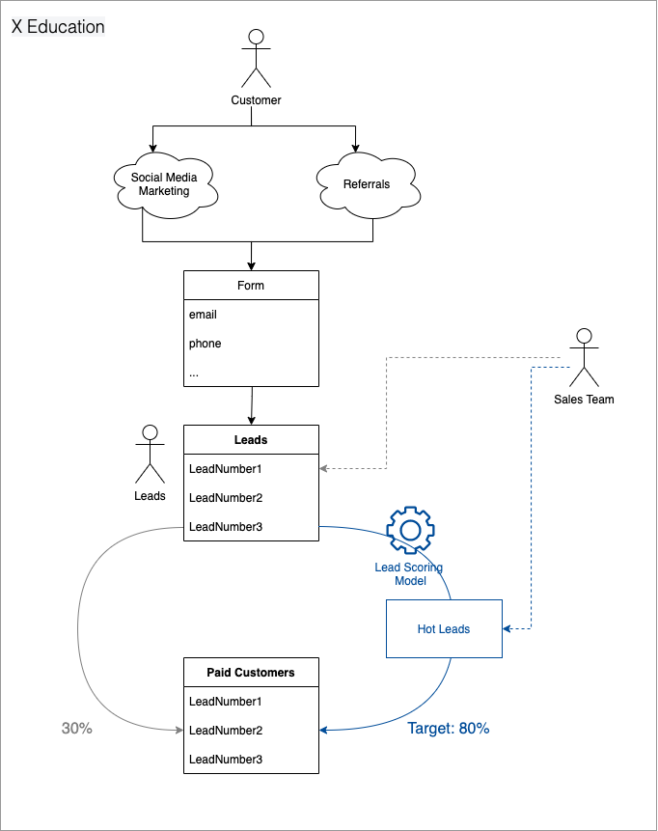
MIND MAP FOR PROBLEM STATEMENT

Slide 5
STRATEGY
The job of model building would be done in below mentioned steps:
DATA CLEANING AND OUTLIER HANDLING: EDA would be read and missing values would be handled as per missing data percentage and relevance of columns.
DATA PREPROCESSING FOR MODEL BUILDING: Spitting of data into test & train set and standardization of numerical column data.
BUILDING LR MODEL ON TRAIN SET: Logistic regression model would be built on train set and best model shall be selected on p values and VIF criteria.
Further model shall be evaluated by creating confusion matrix, ROC Curve and cut off points shall be governed by Accuracy-Sensitivity-Specificity curve. Further we would look into precision and Recall.
CHECKING THE MODEL ON THE TEST SET: The model shall be tested on test data set and it’s evaluation shall be satisfactory.
DRAWING BUSINESS INSIGHTS ON THE BASIS OF DEVELOPED MODEL: Business insights on the basis of model shall be done, best & worst indicators shall be identified and actionable insights would be drawn.

Slide 6
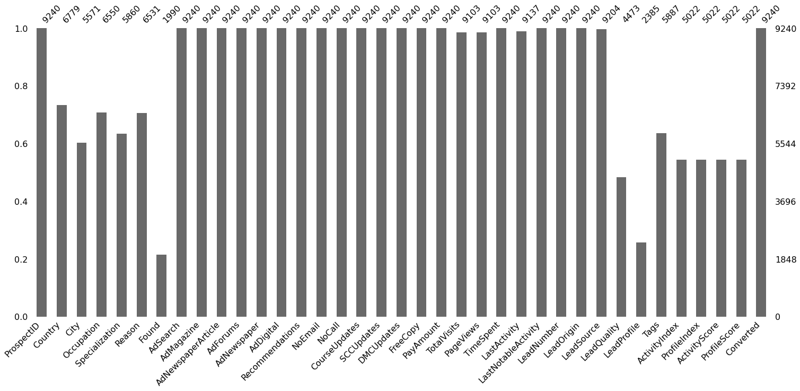
MISSING/INVALID DATA – AT A GLANCE

Slide 7
COLUMN WISE ACTION
COLUMN NAME | DESCRIPTION | ACTION
COLUMN_IDs – Prospect ID | This is one of the unique identifier of the client | This needs to be dropped from analysis as no significance is added by the data
COLUMN - COUNTRY | This column has majority entries of India and few entries from some other countries | If we import missing values with mode, India, most values would become India, for remaining we may rename all the countries as others
COLUMN - CITY | Cities in which client is living | Many countries (not India) have City as "'Thane & Outskirts', 'Other Cities of Maharashtra', 'Mumbai' which is incorrect. So we should drop City.
COLUMN- OCCUPATION, SPECIALIZATION & REASON | Occupation, Specialization & Reason for joining the course | Reason – Only 0.03% rows have values other than Better Career Prospects, thus should drop the column Occupation & Specialization – Replace the missing values with UNKNOWN
COLUMNS –FOUND, ADSEARCH, ADMAGAZINE, ADNEWSPAPER, ARTICLE ADFORUMS ADNEWSPAPER | Where customer has found an Ad on X Education | Found – Group all missing values as unknown Ads & Recommendation – Remove Column as nearly all values are No and thus would not any particular significance.
COLUMNS - TOTALVISITS PAGEVIEWS TIMESPENT LASTACTIVITY, LASTNOTABLEACTIVITY | Activities performend by the client | TotalVisits – Impute with median PageViews – Impute with median TimeSpent – No action LastActivity – Remove rows with null values

Slide 8
COLUMN WISE ACTION
COLUMN NAME | DESCRIPTION | ACTION
COLUMNS – LeadNumber, LeadOrigin, LeadSource, LeadQuality, LeadProfile, Tags | Description of leads provided by sales team | LeadNumber – Drop as this is an ID LeadQuality - Replace missing values with UNKNOWN LeadProfile - LeadProfile has 74% of the values missing. Drop the column Tags - Drop tags column as including it gives a bad test accuracy and sensitivity
COLUMNS – ActivityIndex, ProfileIndex, ActivityScore, ProfileScore | An index and score assigned to each customer based on their activity and their profile | Almost half of the values are missing. Remove the column
Target Column - Converted | Whether lead has converted or not | Target variable is a binary value - 0 or 1 The data is not imbalanced.
COLUMN – LAST ACTIVITY & LAST NOTABLE ACTIVITY | These columns capture data of last activity done by the client | Detailed study of activities captured by the columns were studied and finally it was observed that Last Notable activity can be dropped

Slide 9
OUTLIERS - HANDLING
The following outliers were identified by using boxplots
TIME SPENT/ PAGE VISITS TIME SPENT: Outliers were present in all these columns. We have imputed the missing values with the median. As the data points are genuine, we are not dropping the rows corresponding to outliers.

Slide 10
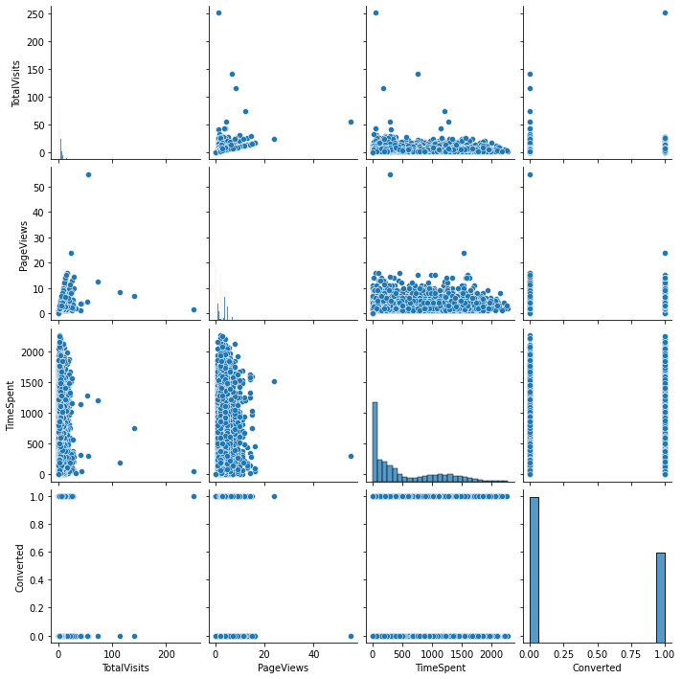
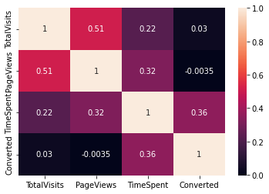
CORRELATION PAIR PLOTS

Slide 11
MODEL BUILDING AND EVALUATION
Now the data is ready for building LR model
Firstly we replace all Yes with 1 & all No with 0
Dummy variables are created for all categorical columns
The data is split into Train and Test dataset
Standard scaling is done for numerical columns
Model is built with all variables, however it was very complex
Next we used RFE to use only top 15 variables
‘Occupation_Housewife’ had high p value, thus we dropped the column and model rerun was done
‘Country_Qatar’ had high p value, thus we dropped the column and model rerun was done
‘LeadSource_WelingakWebsite’ had high p value, thus we dropped the column and model rerun was done
VIF values are also very stable
Finally a good model was developed

Slide 12
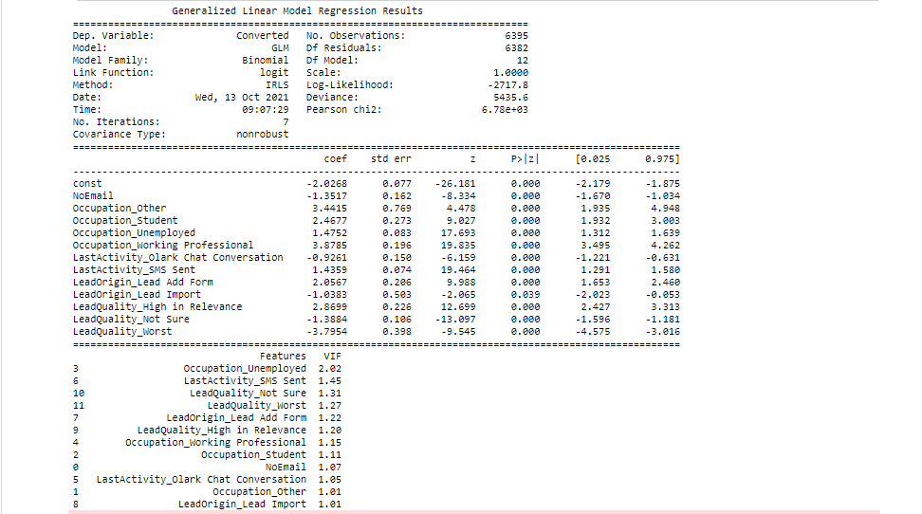
DEVELOPED LR MODEL

Slide 13
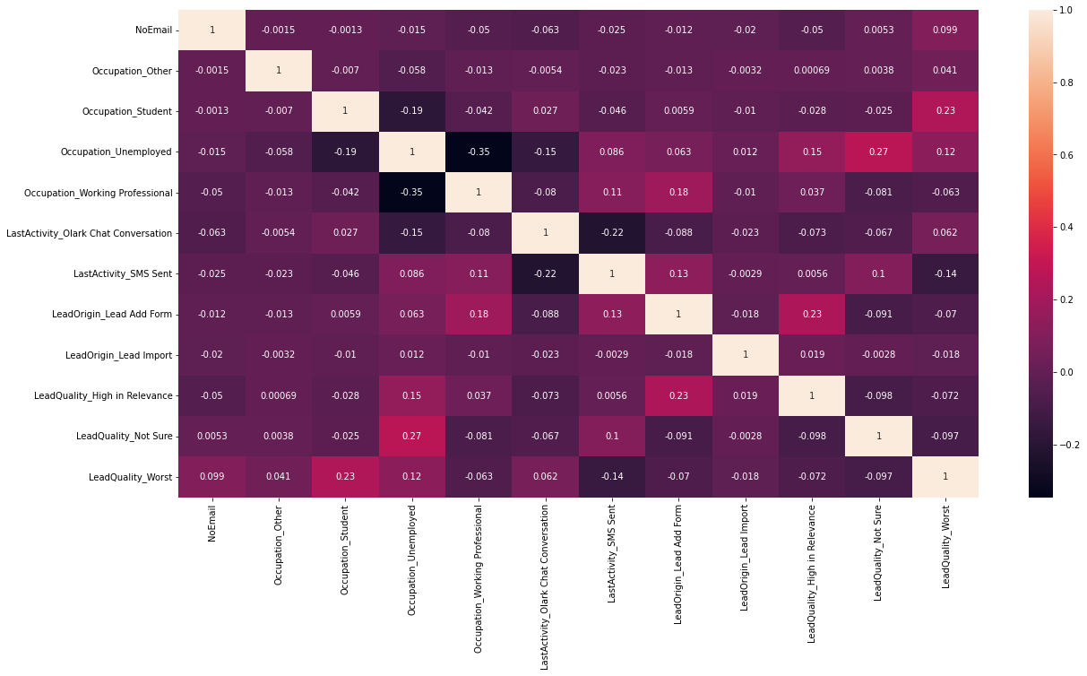
CORRELATION BETWEEN COLUMNS SELECTED IN RFE

Slide 14
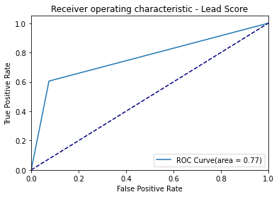
EVALUATION OF MODEL ON TRAINING DATA SET
CONFISION MATRIX
Actual/Predicted | Negative | Positive
Negative | 3667 | 297
Positive | 959 | 1472
ACCURACY – 80.63 %
SENSITIVIY – 60.55 %
SPECIFICITY- 92.51 %
FALSE POSITIVE RATE (FPR) – 7.49%

Slide 15
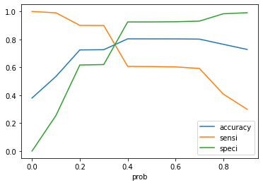
DETERMINE OPTIMUM CUT-OFF & NEW y VARIABLE WITH OPTIMUM CUTOFF
NEW CONFISION MATRIX
CUT OFF POINT = 0.35
Actual/Predicted | Negative | Positive
Negative | 2456 | 1508
Positive | 243 | 2188
ACCURACY – 72.68 %
SENSITIVIY – 90.0 %
SPECIFICITY- 61.96 %
FALSE POSITIVE RATE (FPR) – 38.04%
Model has good accuracy & Sensitivity

Slide 16
EVALUATION OF MODEL ON TEST DATA SET
CONFISION MATRIX
Actual/Predicted | Negative | Positive
Negative | 838 | 855
Positive | 208 | 841
ACCURACY – 61.23 %
SENSITIVIY – 80.17 %
SPECIFICITY- 49.55 %
FALSE POSITIVE RATE (FPR) – 50.55%
The accuracy & Sensitivity has dropped, however the model has performed satisfactorily on test set

Slide 17
EVALUATION OF THE MODEL
variable | co-efficient | Interpretation
Occupation_Working Professional | 3.8785 | Working Professionals are more likely to convert to paid users
Occupation_Other | 3.4415 | Customers with occupation Other are more likely to convert to paid users
LeadQuality_High in Relevance | 2.8699 | Leads marked with High Relevance are more likely to convert to paid users
Occupation_Student | 2.4677 | Students are likely to convert to paid users
LeadOrigin_Lead Add Form | 2.0567 | Leads from filling a form are likely to convert to paid users
Occupation_Unemployed | 1.4752 | Unemployed customers are likely to convert to paid users
LastActivity_SMS Sent | 1.4359 | In cases where SMS was sent, customers are likely to convert to paid users
LastActivity_Unsubscribed | 1.3751 | In cases where the notifications were unsubscribed, customers are likely to convert to paid users
LastActivity_Olark Chat Conversation | -0.9261 | -
LeadOrigin_Lead Import | -1.0383 | -
LeadQuality_Not Sure | -1.3884 | Leads that are marked as Not sure are less likely to convert to paid users
NoEmail | -1.3517 | Customers who have marked Do Not Email as Yes are less likely to convert to paid users OR Customers who have marked Do Not Email as No are more likely to convert to paid users
const | -2.0268 | -
LeadQuality_Worst | -3.7954 | Leads marked as Worst quality are least likely to convert to paid users

Slide 18
SCORE OUT OF 100 TO EACH CLIENT
Train and test data set were merged and predicted probability was multiplied by 100 to
generate a score out of 100. Overview of the same is shown below.
We may give suggestion to X Education, that all clients with score > 35 shall be contacted for obtaining 80% Conversion rate and may be termed as hot lead.
Lead_ID | Client_Score
8701 | 11.64
6684 | 37.66
4406 | 94.98
2487 | 70.77
561 | 37.66
... | ...
579 | 13.25
968 | 36.55
4477 | 81.83
4528 | 36.55
7581 | 3.59

Slide 19
THANK YOU

